Slide 1
Deadly Fire Fallout
Project 1
API Calls

Slide 2
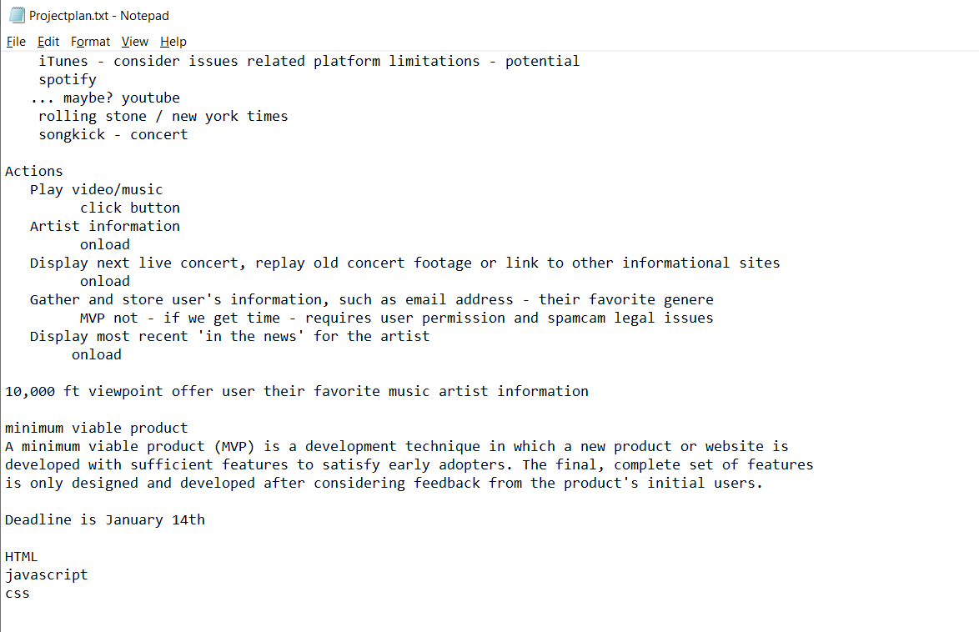
Initial Concept
Gather information from different APIs
Pull from Billboard Magazine current top artists
Pull youtube related to the user query
Pull news
Notes:
Elevator pitch – one minute description of your application
User story – I want to quickly gather information about news, people, weird topics

Slide 3
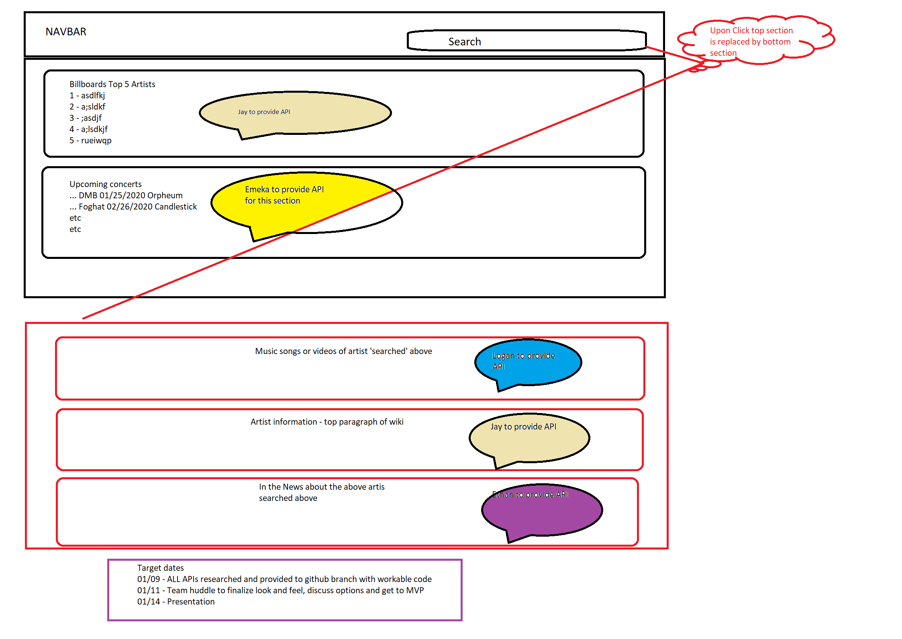
Notes:
Broke the project down into api jquery calls with basic page design with assigned roles
Each of us had to get a different api call to work with a workable frontend design
Challenges were – getting filters to work on some apis – for example we had to abandon Wikipedia

Slide 4
Final Result
http://localhost:52330/index.html

